Slide 1
DEM of a Granular-Jamming Soft Segment
Ursa

Slide 2
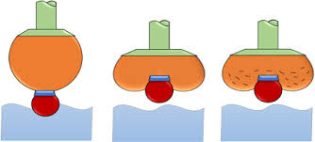
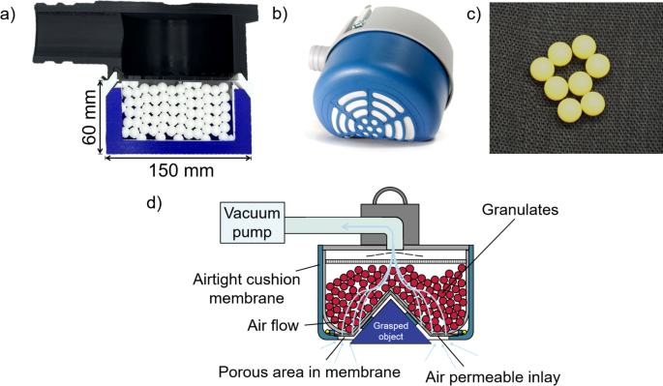
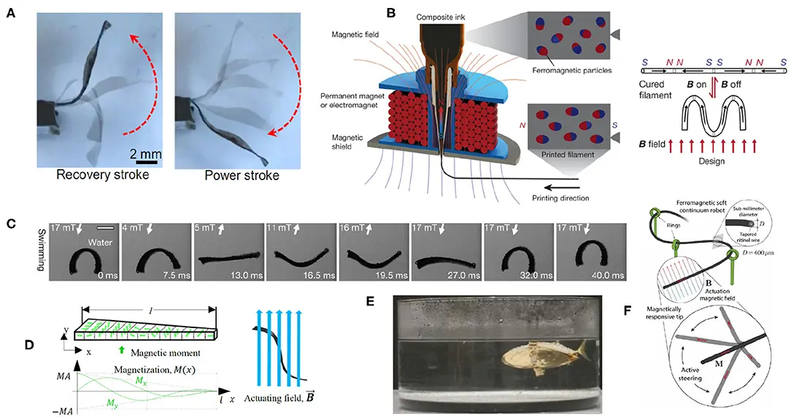
Granular jamming: if you pull a vacuum on a bag of grains, it suddenly becomes very stiff.
Unjammed: low stiffness for safe, dexterous motion and tip positioning.
Jammed: high stiffness for accurate shape holding and payload support.

Slide 3
How does vacuum level (jamming) change the effective bending stiffness of the segment?
How do microscopic parameters (bead radius, bead count / packing, jamming profile along the length) influence:
  Tip deflection under load
  Curvature distribution
  Stored elastic energy
Can a bonded-particle DEM model capture both:
  The soft, floppy unjammed behavior
  The stiff, shape-holding jammed behavior?

Slide 4
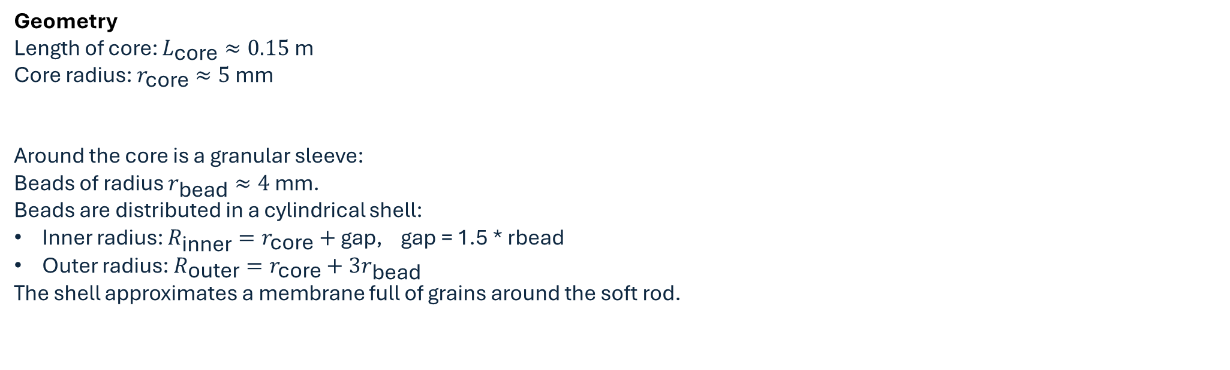
Jamming and Vacuum Level
$v=0$: unjammed (soft, low contact stiffness).
$v=1$: fully jammed (high contact stiffness).
Geometry
Length of core: $L_{\text{core}}≈0.15 \text{m}$
Core radius: $r_{\text{core}}≈5 \text{mm}$
Around the core is a granular sleeve:
Beads of radius $r_{\text{bead}}≈4 \text{mm}$.
Beads are distributed in a cylindrical shell:
  Inner radius: $R_{\text{inner}}=r_{\text{core}}+\text{gap}$, gap = 1.5 * rbead
  Outer radius: $R_{\text{outer}}=r_{\text{core}}+3r_{\text{bead}}$
The shell approximates a membrane full of grains around the soft rod.

Slide 5

Material Properties
Core:
Density $ρ_{\text{core}}≈900 {\text{kg}\text{/}\text{m}}^{3}$(soft polymer).
Young’s modulus $E_{\text{core}}≈50 \text{kPa}$.
Behaves approximately like a linear elastic rod in small strain.
Sleeve (grains):
Density $ρ_{\text{bead}}≈1500 {\text{kg}\text{/}\text{m}}^{3}$.
Treated as rigid spheres with contact interactions.
Environment:
Gravity $g=\left(0 , − , 9.810\right) {\text{m}\text{/}\text{s}}^{2}$.
Simple flat ground plane at $y=−0.03 \text{m}$, modeled with a penalty contact.

Slide 6

Number of core particles: $N_{\text{core}}=21$
Spacing:
$Δx=L_{\text{core}}/\left(N_{\text{core}}−1\right)$.
Neighboring nodes are connected by Linear springs:
Axial stiffness:
$$k_{\text{bond}}=\frac{E_{\text{core}}A_{\text{core}}}{Δx}.$$
Dashpot coefficient $c_{\text{bond}}$ for viscoelastic damping.
For nodes $i$and $j=i+1$:
Current separation:
$$ℓ=∥x_{j}−x_{i}∥, e=\frac{x_{j}−x_{i}}{ℓ}.$$
Extension: $e=ℓ−Δx$.
Relative velocity along the bond: $\dot{e}=\left(v_{j}−v_{i}\right)⋅e$
Bond force:
$$F_{ij}=\left(k_{\text{bond}} e+c_{\text{bond}} \dot{e}\right)e.$$
Assemble internal forces by adding $+F_{ij}$to node $j$and $−F_{ij}$to node $i$

Slide 7

For any pair of particles $i$and $j$:
Positions: $x_{i},x_{j};$Radii: $r_{i},r_{j};$Relative vector: $d=x_{j}−x_{i};$distance $d=∥d∥;$Normal unit vector: $n=d/d$.
Contact occurs when: $\text{overlap}=r_{i}+r_{j}−d>0$
Normal force (spring–dashpot): $F_{n}=k_{\text{contact}}\left(v_{\text{pair}}\right) \text{overlap}+c_{\text{contact}} \dot{δ}$
Tangential friction:
Tangential relative velocity: $v_{t}=\left(v_{j}−v_{i}\right)−\dot{δ}n$
Viscous friction force $F_{t}^{\text{visc}}=−c_{\text{tangent}} v_{t}$
Total contact force on particle $i$: $F_{i}^{\text{contact}}=−\left(F_{n}+F_{t}\right), F_{j}^{\text{contact}}=+\left(F_{n}+F_{t}\right)$
Gravity and Ground Plane
Gravity: each particle gets a body force $F_{\text{grav}}=m_{i}g$
Ground plane at $y=y_{\text{ground}}$

Slide 8
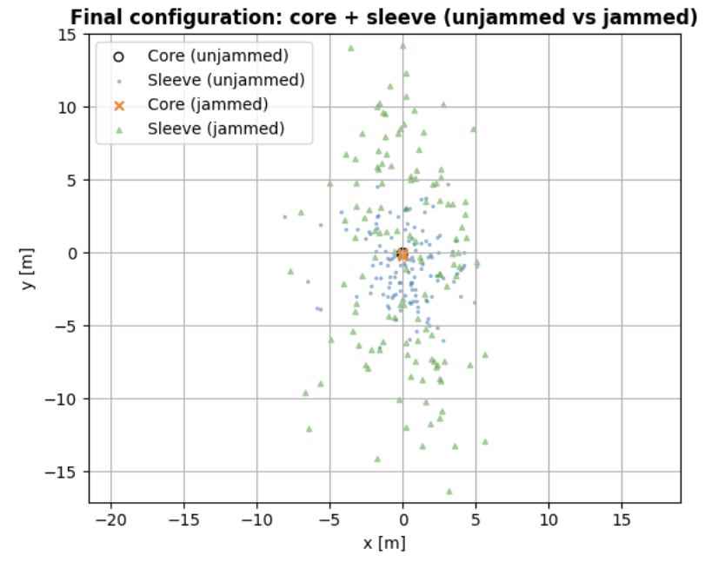
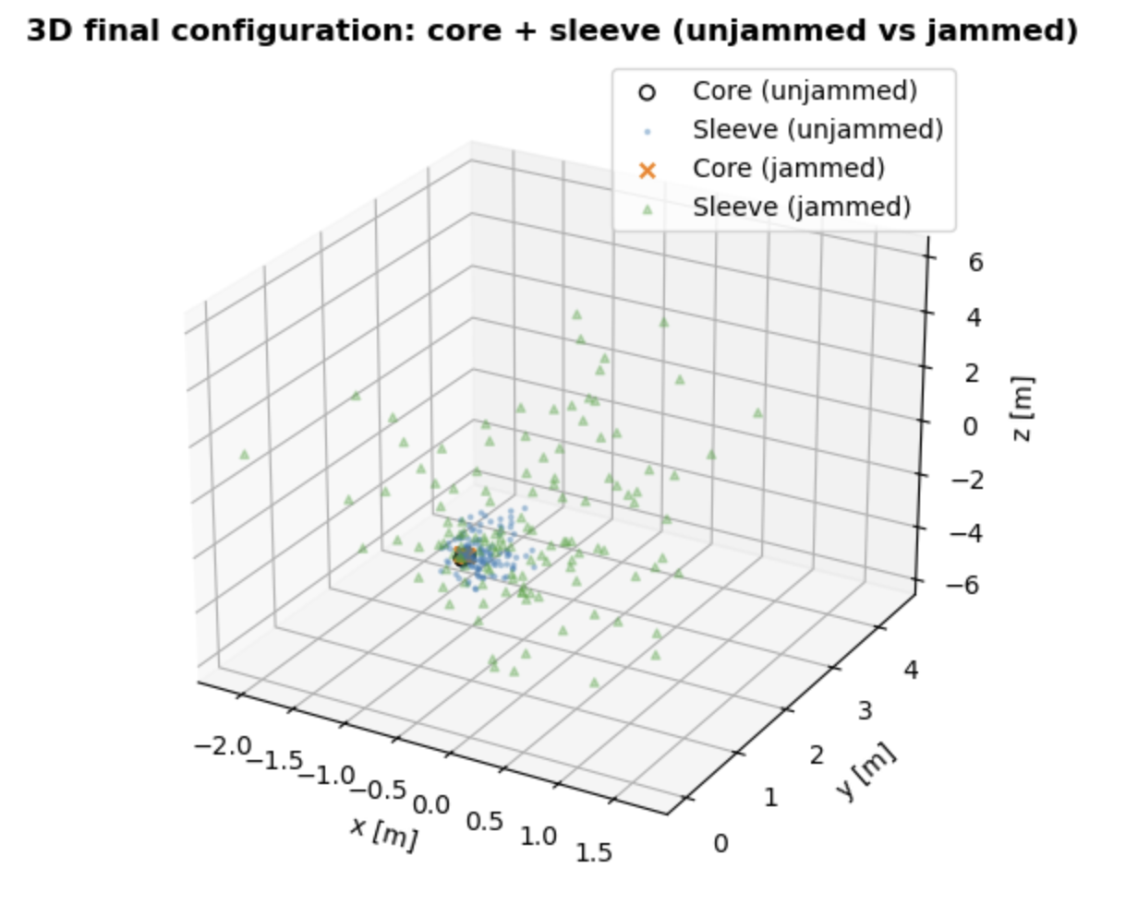

Slide 9
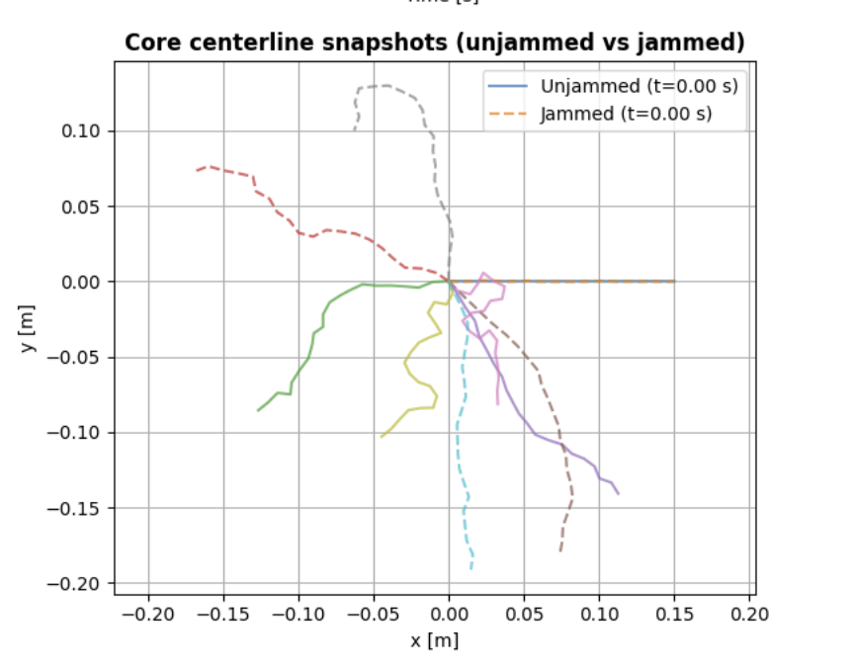
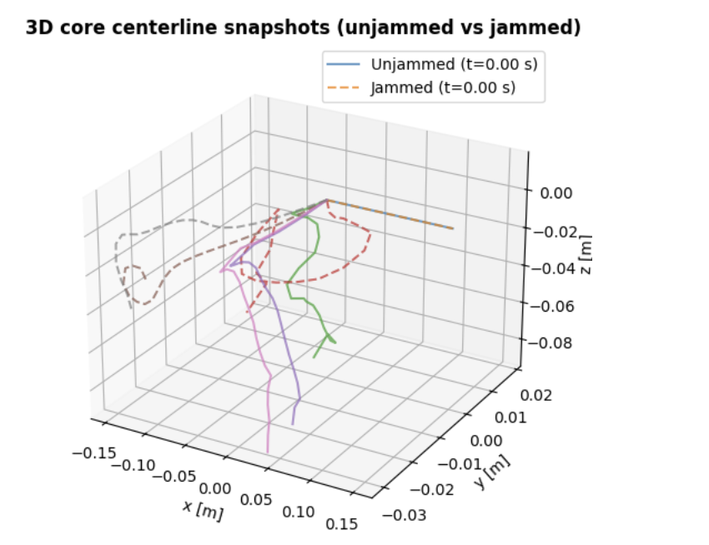

Slide 10
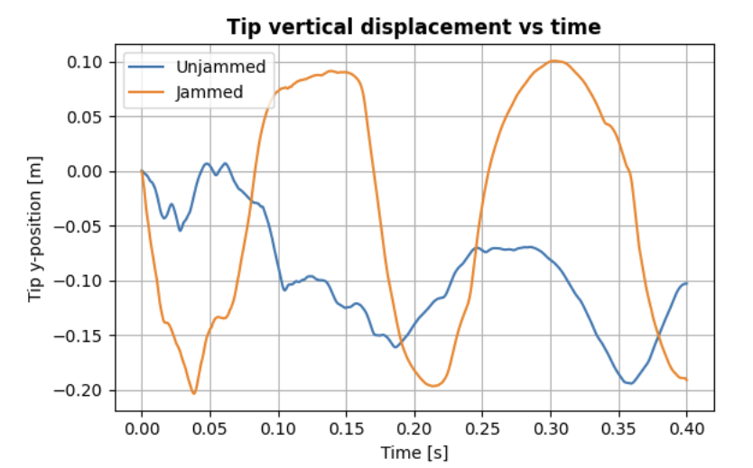
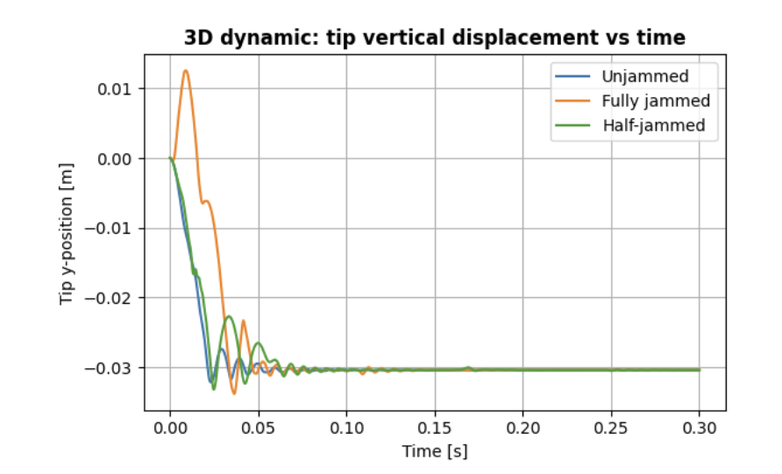

Slide 11
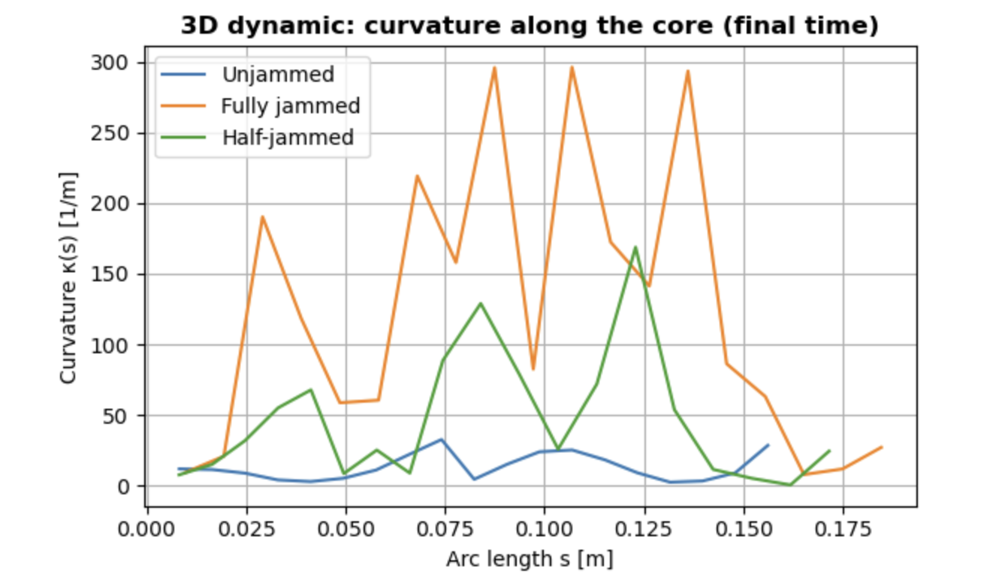
Dynamic bond energy (unjammed): 2.715e-03 J
Dynamic bond energy (jammed): 5.428e-01 J
Dynamic bond energy (half-jam): 2.864e-01 J

Slide 12
